Slide 1
Introduction to BOKU and its role in SWARM
Priv.-Doz. DI Dr. Michael Tritthart
University of Natural Resources and Life Sciences BOKU, Vienna
Kick-off meeting / 21st December 2018
This project has been funded with support from the European Commission. This publication reflects the views only of the author, and the Commission cannot be held responsible for any use which may be made of the information contained therein.

Slide 2
Mission Statement
BOKU – University of Natural Resources and Life Sciences, Vienna
„It is BOKU´s core competence to research and impart knowledge of sustainably using natural resources and thus providing options to safeguard natural resources. Thereby the „University of Life“ offers answers to issues that affect the general public and that are highly relevant for each and everyone of us.“

Slide 3
Facts & Figures
Students
… from Austria | 9.728
… from the EU | 1.946
… from third countries | 606
Overall | 12.280
Staff
Scientific staff | 1.004
Non-scientific staff | 580
Overall staff | 1.584
Study programs
Bachelor | 8
Master | 26
PhD | 4
Overall | 38

Slide 4
Organisation
University (BOKU)
15 Departments (Department of Water, Atmosphere and Environment – WAU)
67 Institutes (Institute of Hydraulic Engineering and River Research)

Slide 5
Study programs
Programs with department responsibility
Bachelor Level
Environmental Engineering (Kulturtechnik und Wasserwirtschaft) | 48%
Master Level
Environmental Engineering (Kulturtechnik und Wasserwirtschaft) | 44%
Water Management and Environmental Engineering (WMEE) | 57%
Applied Limnology (MAL) | 100%
Natural Resources Management and Ecological Engineering (NARMEE) | 38%
Environmental Sciences – Soil, Water and Biodiversity (ENVEURO) | 35%
Alpine Natural Dangers / Watershed Regulation | 11%

Slide 6
Research fields
Water management Relation between water and environment, sustainable water use
Hydrology Hydrological processes as a foundation for all water related planning and constructions; focus on discharge
Hydraulic engineering Selection of technical measures to support economic and social interests, considering the ecological functionality

Slide 7
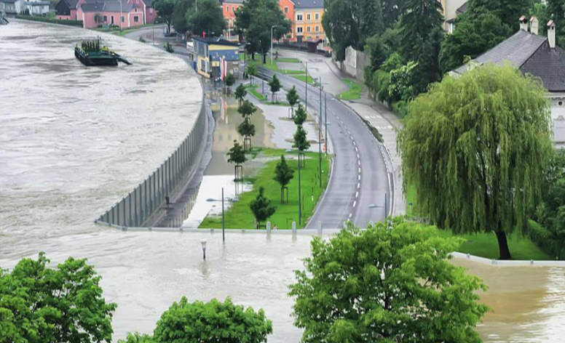
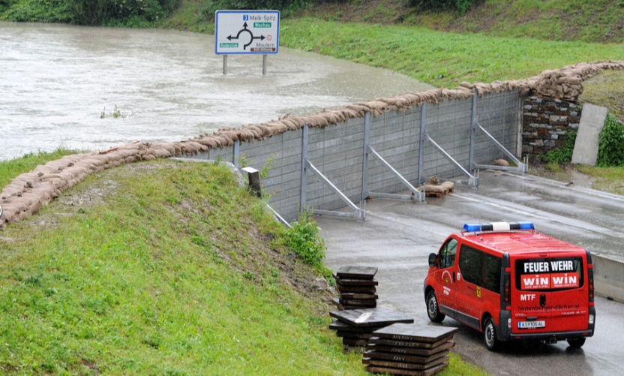
Related projects
Floods documentation June 2013
Analysis of precipitation and discharge
Documentation of inundated areas
Analysis of sediment budget and morphology
Effects of implemented protective measures
(BMLFUW, 2015)

Slide 8
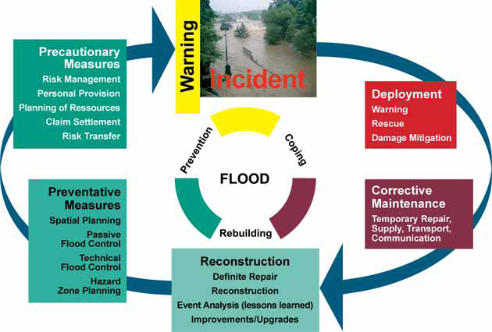
Related projects
Flood risk I and II
Analysis of natural hazard documentations
Recommendations for future improvements („lessons learned“)
Development of effective implementation strategies for integrated flood management
(BMLFUW, 2004)

Slide 9
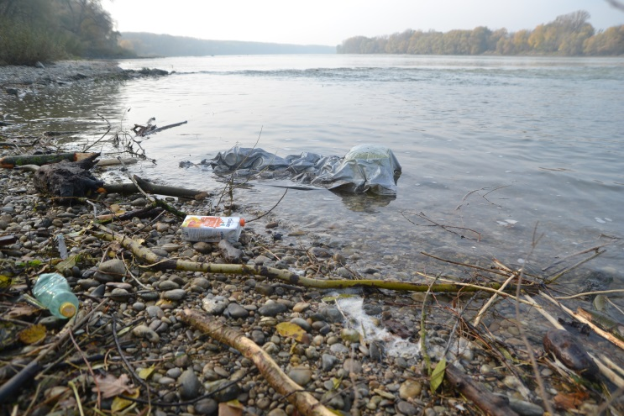
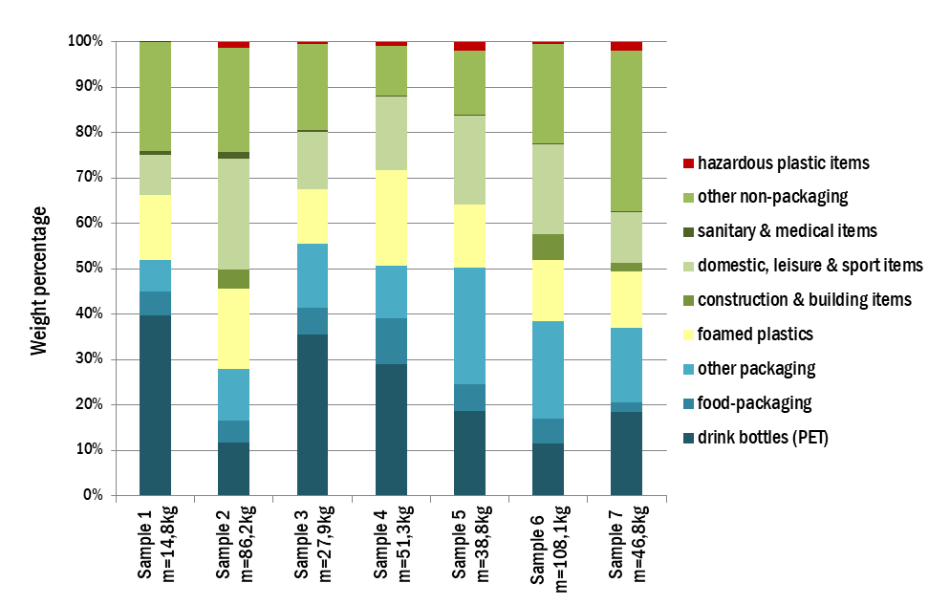
Related projects
PlasticFreeDanube
Investigation of macro plastic waste (>5mm) in and along the Danube river
Development of a methodological approach on plastic waste in terms of
entrance points
quantities
transport patterns
environmental threats
© BOKU/Sebastian Pessenlehner
© PlasticFreeDanube

Slide 10
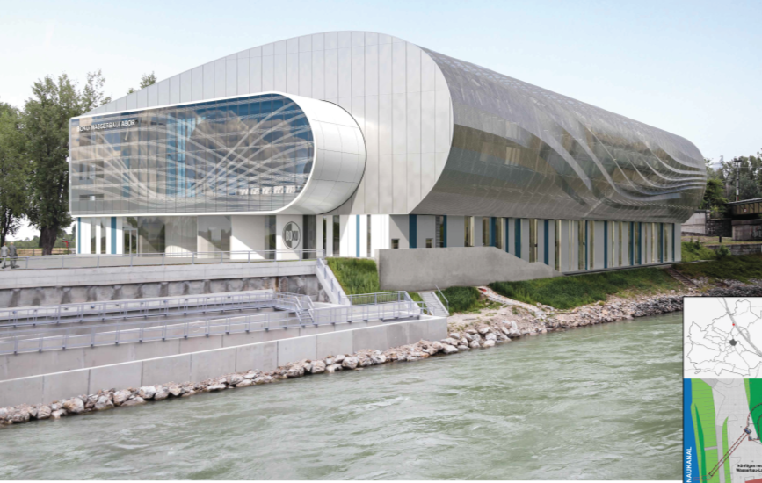
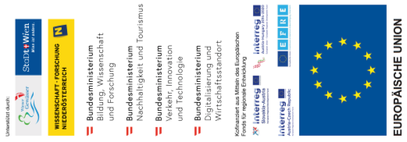
Related projects
DREAM (Danube River Research And Management)
Construction of a new hydraulic engineering laboratory
Free surface flow of 10m³/s
Dimensions 100m x 25m
Flagship-project of the EU strategy for the Danube region
4 ongoing projects (SEDECO, SEDDON II, DREAM SK-AT, Wasserbaulabor RRMC)
Subject areas
Basic research
Flood risk management
Hydraulic engineering
Renewable energy
Waterways management
Eco-hydraulics
© BOKU

Slide 11
Role of BOKU in the project
Lead of WP1 “Analysis of water resources management in the Western Balkan region” - WB regional issues - EU water policies, innovation and legislation - Master curricula related to WRM in WB and EU - Workshop May 8-10, Vienna, Austria ➔ presentation by Kurt Glock tomorrow
Contribution to the development of competence-based curricula and trainings
Conduction of a training workshop for teaching staff (3 days in February 2020)
Summer school for students (5 days in June 2021)

Slide 12
Contact information
University of Natural Resources and Life Sciences Vienna (BOKU)
Department of Water, Atmosphere and Environment (WAU)
Institute of Hydraulic Engineering and River Research (IWA)
Find more about us in
http://www.wau.boku.ac.at/en/
Michael Tritthart
Priv.-Doz. Dipl.-Ing. Dr.techn.
E-mail: michael.tritthart@boku.ac.at
Kurt Glock
Dipl.-Ing.
E-mail: kurt.glock@boku.ac.at

